Slide 1
ECWM506 – Anne-Gaelle Colom

Slide 2

jQueryMobile
ECWM506 – Anne-Gaelle Colom

Slide 3
Mobile Web is massive
6.6 7.0
Billion
Supscriptions People
http://mobithinking.com/mobile-marketing-tools/latest-mobile-stats/a#uniquesubscribers

Slide 4
14.7 Billion (+3b since last year!)
Devices on the
Internet
Different:
UI capabilities
Screen sizes
Interaction styles
Source: Cisco
http://blogs.cisco.com/news/cisco-connections-counter/

Slide 5
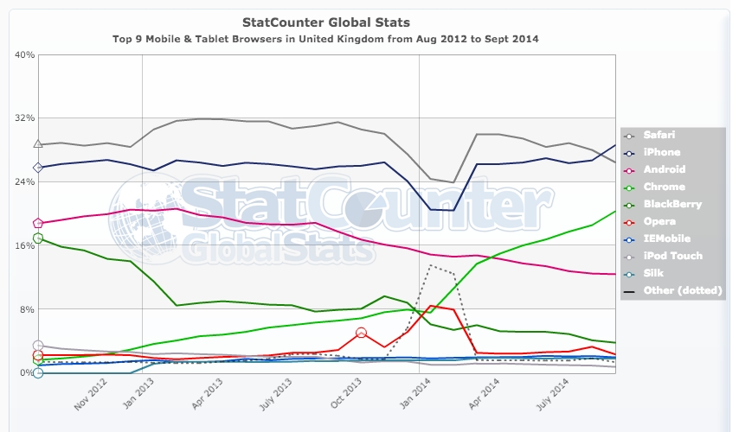
Mobile Browser Aug 12– Sept 14 UK

Slide 6
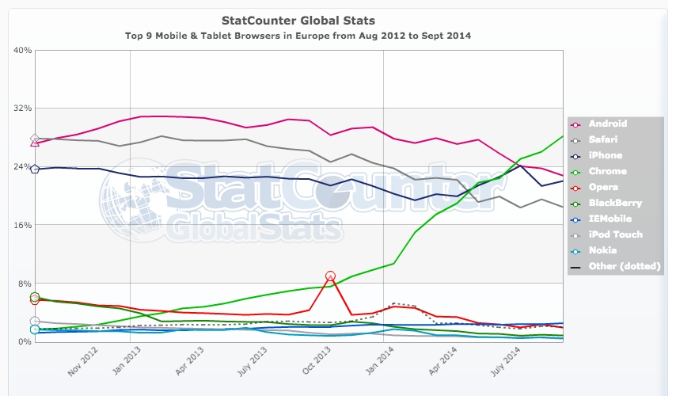
Mobile Browser Aug 12– Sept 14 Europe

Slide 7
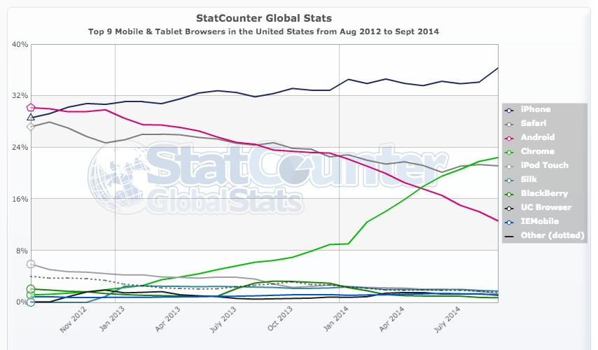
Mobile Browser Aug 12– Sept 14 USA

Slide 8
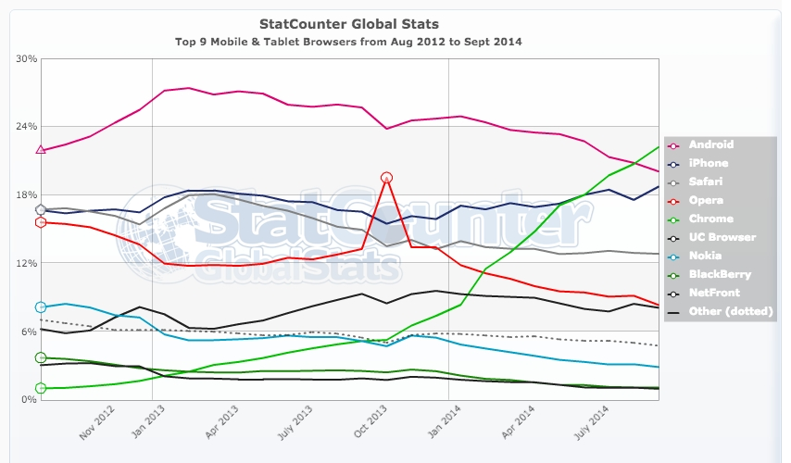
Mobile Browser Aug 12– Sept 14 Worldwide

Slide 9
My involvement with jQueryMobile
Contributor since Alpha 1 (Sept 2010)
Team Member since October 2011, Documentation Lead.
Elected to jQuery Board of Directors (April 2013)

Slide 10

One codebase All platforms

Slide 11
Progressive enhancement
Works everywhere
Experience varies based on device capabilities

Slide 12
Progressive enhancement

Slide 13

Built on standard

Slide 14
… and on jQuery core
Mobile and Tablet UI
Tools and Utilities

Slide 15
Familiar API, tight file size
93kb
199kb

Slide 16
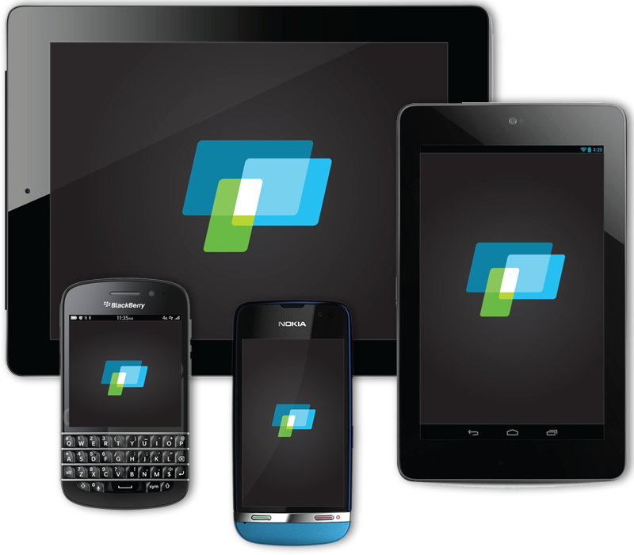
Unified user experience (UX)

Slide 17
Supported platforms

Slide 18

Work also on desktop browsers

Slide 19









The Project Team in 2012

Slide 20


The Project Team Today

Slide 21
Anatomy of a page

Slide 22
HTML5 document
<!DOCTYPE html>
<html>
<head>
<meta charset="utf-8">
<title>jQuery Mobile Page</title>
</head>
<body>
</body>
</html>

Slide 23

jQuery, Mobile + Theme CSS
<!DOCTYPE html>
<html>
<head>
<meta charset="utf-8">
<title>jQuery Mobile Page</title>
<meta name="viewport" content="width=device-width, initial-scale=1">
<link rel="stylesheet" href="http://code.jquery.com/mobile/1.4.5/jquery.mobile-1.4.5.min.css">
<script src="http://code.jquery.com/jquery-1.10.2.min.js"></script>
<script src="http://code.jquery.com/mobile/1.4.5/jquery.mobile-1.4.5.min.js"></script>
</head>
Check latest versions on jQuery Mobile Website

Slide 24
Data-role="page"
<body>
<div data-role="page">
<!-- jQuery Mobile page content goes here -->
</div> <!-- /page -->
</body>

Slide 25
Page data-roles/role
data-role header
role=“main” class=“ui-content”
data-role footer

Slide 26
Page data-roles
<body>
<div data-role="page">
<div data-role="header">
</div>
<div role="main" class="ui-content">
</div>
<div data-role="footer">
</div>
</div><!-- /page -->
</body>

Slide 27
Simple content
<body>
<div data-role="page">
<div data-role="header">
<h1>Welcome</h1>
</div>
<div role=”main" class="ui-content">
<p>Hello world</p>
</div>
</div><!-- /page -->
</body>

Slide 28
Basic list
<div role=”main"
class="ui-content">
<p>Hello world</p>
<ul>
<li>Products</li>
<li>Services</li>
<li>About us</li>
<li>Contact</li>
</ul>
</div><!-- /content -->

Slide 29
Add listview data-role
<div role="content"
class="ui-content">
<p>Hello world</p>
<ul data-role="listview”
data-inset=“true”>
<li>Products</li>
<li>Services</li>
<li>About us</li>
<li>Contact</li>
</ul>
</div><!-- /content -->

Slide 30
Link each item
<div role="content" class="ui-content">
<p>Hello world</p>
<ul data-role="listview" data-inset="true">
<li><a href="products.html">Products</a></li>
<li><a href="services.html">Services</a></li>
<li><a href="about.html">About us</a></li>
<li><a href="contact.html">Contact</a></li>
</ul>
</div><!-- /content -->

Slide 31
Linked list items

Slide 32
Summary
simple list
data-role=listview
linked list

Slide 33
Theming

Slide 34
Theming pages
jQuery Mobile has a rich theming system
Full control of page style
Full control of page widgets
data-theme can be applied to header, footer and page.
Default theme mixes styles from multiples swatches for visual texture and optimal contrast.

Slide 35
Theme Swatches

Slide 36
Theme swatches
a: light theme
b: dark theme

Slide 37
Default Theme (Theme a)

Slide 38
Theme b

Slide 39
data-theme swatch
<div data-role="header" data-theme="b"> <h1>Page Title</h1>
</div>
<div role="main" class="ui-content”>
<p>Hello world</p>
<ul data-role="listview" data-inset="true" data-theme="b">
<li><a href="products.html">Products</a></li>
<li><a href="services.html">Services</a></li>
<li><a href="about.html">About us</a></li>
<li><a href="contact.html">Contact</a></li>
</ul>
</div><!-- /content -->
<div data-role="footer" data-theme="b"> <h4>Page Footer</h4>
</div>

Slide 40
Theming
data-theme=“b”
default
data-theme=“b”
data-theme=“b”

Slide 41
Page linking

Slide 42
Multiple page example: Each page has a unique ID
<body>
<div data-role="page" id="home">
</div><!-- /home page -->
<div data-role="page" id="products">
</div><!-- /products page -->
<div data-role="page" id="services">
</div><!-- /services page -->
<div data-role="page" id="about">
</div><!-- /about page -->
<div data-role="page" id="contact">
</div><!-- /contact page -->
</body>

Slide 43
...with internal #anchor links
<div role="main" class="ui-content”>
<p>Hello world</p>
<ul data-role=”listview" data-inset="true” data-theme=“b">
<li><a href=”#products">Products</a></li>
<li><a href=”#services">Services</a></li>
<li><a href=”#about">About us</a></li>
<li><a href=”#contact">Contact</a></li>
</ul>
</div><!-- /content -->

Slide 44
data-ajax="false"
<a href="multi.html" data-ajax="false">Multi</a>
*Required if linking TO a multi-page file to avoid
hash namespace collisions

Slide 45
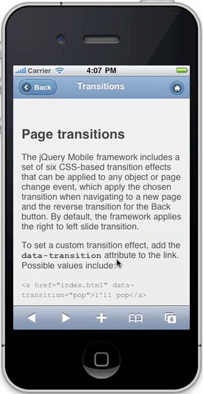
data-transition="pop”

Slide 46
data-direction="reverse"
<a href="index.html" data-transition="pop" data-direction="reverse">Home</a>

Slide 47
data-rel="dialog"
<a href="products.html" data-rel="dialog">Home</a>

Slide 48
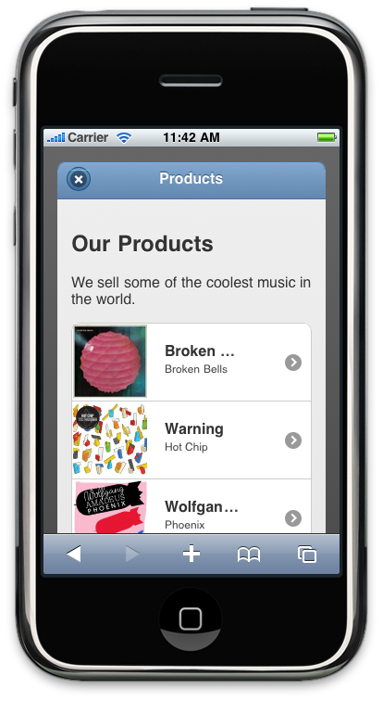
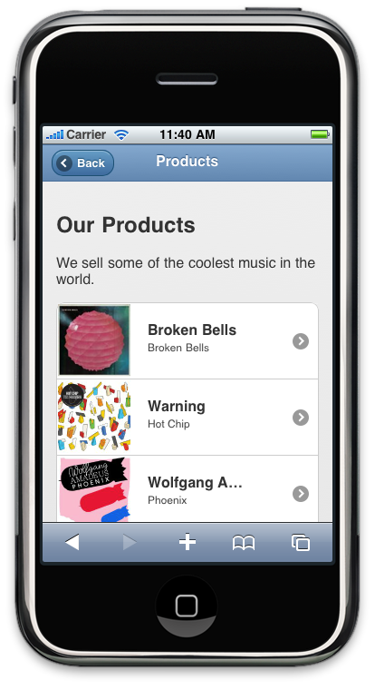
data-rel="dialog"
normal link

Slide 49
Same transition attribute
<a href="products.html" data-rel="dialog" data-transition="flip">Open dialog</a>

Slide 50
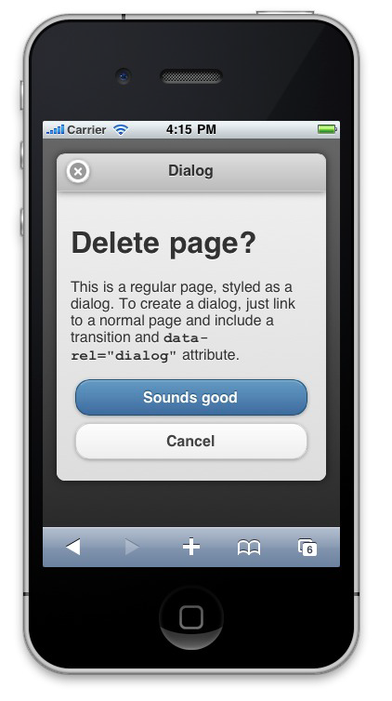

Slide 51
Closing dialogs
<a href="index.html" data-rel="back">Done</a>
or via JS…
$('.ui-dialog').dialog('close’)
or even…
window.history.back();

Slide 52
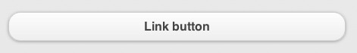
Link styled as a button
<a href="index.html" class=“ui-btn”>Link button</a>

Slide 53
Buttons
Add classes to links and button elements:
<a href="index.html" class=“ui-btn”>Anchor</a>
<button class=“ui-btn”>Button</button>

Slide 54
Button Widget
Input buttons:
<form>
<input type="button" value="Button”>
<input type="submit" value="Submit”>
<input type="reset" value="Reset">
</form>

Slide 55
Button Widget - Corners
Input buttons:
<form>
<input type="button" value="Has corners by default"> <input type="button" data-corners="false" value="Unset corners">
</form>

Slide 56
Button Widget - shadow
Input buttons:
<form>
<input type="button" value="Has corners by default"> <input type="button" data-shadow="false" value="Unset shadow">
</form>

Slide 57
Button classes
For links styled as buttons and button elements, add:
ui-shadow to add a shadow
ui-corner-all to add corners
ui-btn-inline to make the buttons inline
ui-btn-a to add the swatch a theme
ui-mini to add the mini style
ui-icon-delete to add the delete icon
ui-btn-icon-left to add an icon to the left

Slide 58
Icons

Slide 59
Icons
<input type=“button” data-icon=“delete” data-icon-pos=“left” value=“delete”>
<a href="delete-confirm.html”
class=“ui-btn ui-icon-delete ui-btn-icon-left”>Delete</a>

Slide 60

Icon Position
data-iconpos="left"
data-iconpos="right"
data-iconpos="top"
data-iconpos="bottom"
data-iconpos=”notext"

Slide 61
Inline buttons
Standard:
page wide
Inline:
more compact
data-inline="true"
<input type=“button”
data-inline="true” value=“Cancel”>
<a href="index.html" class=“bui-btn ui-btn-inline ui-btn-b”> Save</a>

Slide 62
Toolbars

Slide 63
Header bars
Standard
<div data-role="header”>
<h1>Edit Contact</h1>
</div>

Slide 64
Header bars
Links in header are automatically turned into buttons
Button position
add the class of ui-btn-left or ui-btn-right to the anchor.
<div data-role="header">
<a href="#" class="ui-btn-left ui-btn ui-btn-inline ui-mini ui-corner-all ui-btn-icon-left ui-icon-delete">Cancel</a>
<h1>My App</h1>
<button class="ui-btn-right ui-btn ui-btn-b ui-btn-inline ui-mini ui-corner-all ui-btn-icon-right ui-icon-check">Save</button>
</div>

Slide 65

Auto back button
Add data-add-back-btn="true” to the header div
You may add data-direction="reverse” to reverse the transition direction
<div data-role=”header" id="two"
data-theme=”a" data-add-back-btn="true"
data-direction="reverse">

Slide 66
Footer bar
Standard
<div data-role="footer">
<h4>Footer content</h4>
</div>

Slide 67
Footer bar
With buttons
<div data-role="footer">
<a href="index.html" data-role="button" data-icon="delete">Remove</a>
<a href="index.html" data-role="button" data-icon="plus">Add</a>
<a href="index.html" data-role="button" data-icon="arrow-u">Up</a>
<a href="index.html" data-role="button" data-icon="arrow-d">Down</a>
</div>

Slide 68
Toolbar with grouped buttons
With grouped buttons
wrap the links in a wrapper with data-role="controlgroup" and data-type="horizontal”
<div data-role="header">
<div data-role="controlgroup" data-type="horizontal" class="ui-mini ui-btn-left">
<a href="#" class="ui-btn ui-btn-icon-right ui-icon-plus">Add</a>
<a href="#" class="ui-btn ui-btn-icon-right ui-icon-arrow-u">Up</a>
<a href="#" class="ui-btn ui-btn-icon-right ui-icon-arrow-d">Down</a>
</div>
<h6>My header</h6>
</div>

Slide 69
Footer bar
With form elements

Slide 70
Persistent Footer
It is possible to keep a persistent footer during a page transition:
add the data-id attribute to the footer of all relevant pages and use the same id value for each.
For example, by adding data-id="myfooter" to the current page and the target page, the framework will keep the footer anchors in the same spot during the page animation.
Must also have header and footer toolbars set to data-position="fixed" so they are in view during the transition.

Slide 71
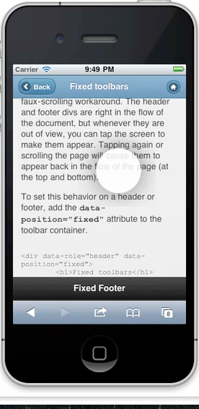
Fixed Positioning
<div data-role="header”
data-position="fixed">
<h1>Fixed toolbars</h1>
</div>
<div role="main" class="ui-content">
...
</div>
<div data-role=”footer”
data-position="fixed">
<h1>Fixed footer</h1>
</div>

Slide 72
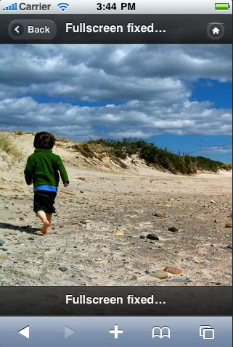
Fullscreen Positioning
apply a data-fullscreen="true" attribute to the div contain that has the attribute data-role="page”
AND
the data-position="fixed" attribute to both the header and footer div elements

Slide 73
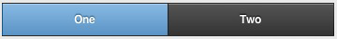
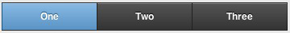

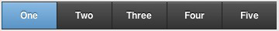
Navbars
Basic navbar widget that is useful for providing up to 5 buttons with optional icons in a bar

Slide 74
Navbars

Slide 75
Navbars
<div data-role="navbar">
<ul>
<li><a href="a.html" class="ui-btn-active">One</a></li>
<li><a href="b.html">Two</a></li>
</ul>
</div><!-- /navbar -->

Slide 76
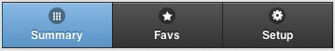
Navbars with icons
Standard mobile icons
<div data-role="footer">
<div data-role="navbar">
<ul>
<li><a href="#" data-icon="grid” class="ui-btn-active">Summary</a></li>
<li><a href="#" data-icon="star”>Favs</a></li>
<li><a href="#" data-icon="gear">Setup</a></li>
</ul>
</div><!-- /navbar -->
</div><!-- /footer -->

Slide 77
Navbars with icons
Control icon position (bottom, top, left, right)
<div data-role="footer">
<div data-role="navbar” data-iconpos="bottom">
<ul>
<li><a href="#" data-icon="grid”>Summary</a></li>
<li><a href="#" data-icon="star” class="ui-btn-active">Favs</a></li>
<li><a href="#" data-icon="gear">Setup</a></li>
</ul>
</div><!-- /navbar -->
</div><!-- /footer -->

Slide 78
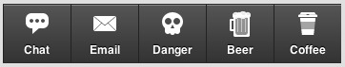
Navbars with icons
3rd part icons e.g. Glyphish
<div data-role="footer" class="nav-glyphish-example”>
<div data-role="navbar" class="nav-glyphish-example" data-grid="d">
<ul>
<li><a href="#" id="chat" data-icon="custom">Chat</a></li>
<li><a href="#" id="email" data-icon="custom">Email</a></li>
<li><a href="#" id="skull" data-icon="custom">Danger</a></li>
<li><a href="#" id="beer" data-icon="custom">Beer</a></li>
<li><a href="#" id="coffee" data-icon="custom">Coffee</a></li>
</ul>
</div>
</div>

Slide 79
Also need style declaration
<style>
.nav-glyphish-example .ui-btn .ui-btn-inner { padding-top: 40px !important; }
.nav-glyphish-example .ui-btn .ui-icon { width: 30px!important; height: 30px!important; margin-left: -15px !important; box-shadow: none!important; -moz-box-shadow: none!important; -webkit-box-shadow: none!important; -webkit-border-radius: 0 !important; border-radius: 0 !important; }
#chat .ui-icon { background: url(glyphish-icons/09-chat2.png) 50% 50% no-repeat; background-size: 24px 22px; }
#email .ui-icon { background: url(glyphish-icons/18-envelope.png) 50% 50% no-repeat; background-size: 24px 16px; }
#login .ui-icon { background: url(glyphish-icons/30-key.png) 50% 50% no-repeat; background-size: 12px 26px; }
#beer .ui-icon { background: url(glyphish-icons/88-beermug.png) 50% 50% no-repeat; background-size: 22px 27px; }
#coffee .ui-icon { background: url(glyphish-icons/100-coffee.png) 50% 50% no-repeat; background-size: 20px 24px; }
#skull .ui-icon { background: url(glyphish-icons/21-skull.png) 50% 50% no-repeat; background-size: 22px 24px; }
</style>

Slide 80
Themed navbar
<div class="ui-body-b ui-body”>
<div data-role="navbar”>
<ul>
<li><a href="#" data-icon="grid”>Summary</a></li>
<li><a href="#" data-icon="star” class="ui-btn-active">Favs</a></li>
<li><a href="#" data-icon="gear">Setup</a></li>
</ul>
</div><!-- /navbar -->
</div><!-- /footer -->

Slide 81
Navbar in header
<div data-role="header”>
<h1>I'm a header</h1>
<a href="index.html" data-icon="gear" class="ui-btn-right">Options</a>
<div data-role="navbar">
<ul>
<li><a href="#">One</a></li>
<li><a href="#">Two</a></li>
<li><a href="#">Three</a></li>
</ul>
</div><!-- /navbar -->
</div><!-- /header -->

Slide 82
Navbar in footer
Acts like a tab bar at the bottom of the page
<div data-role="footer">
<div data-role="navbar">
<ul>
<li><a href="#">One</a></li>
<li><a href="#">Two</a></li>
<li><a href="#">Three</a></li>
</ul>
</div><!-- /navbar -->
</div><!-- /footer -->

Slide 83
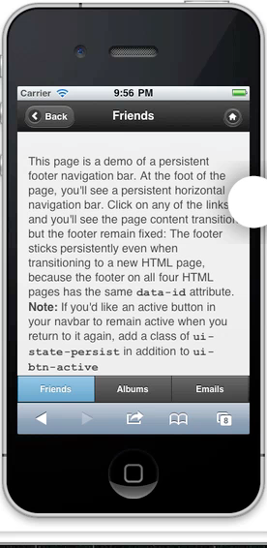
Persistent footer nav bar
<div data-role="footer" data-id="foo1" data-position="fixed">
<div data-role="navbar">
<ul>
<li><a href=”friends.html" class="ui-btn-active ui-state-persist">Friends</a></li>
<li><a href="albums.html">Albums</a></li>
<li><a href="emails">Emails</a></li>
</ul>
</div><!-- /navbar -->
</div><!-- /footer -->

Slide 84
Persistent footer nav bar
The footer sticks persistently even when transitioning to a new HTML page, because the footer on all four HTML pages has the same data-id attribute.
Note: If you'd like an active button in your navbar to remain active when you return to it again, add a class of ui-state-persist in addition to ui-btn-active

Slide 85
HTML formatting

Slide 86
HTML formatting

Slide 87
A single long page

Slide 88
Multi-page

Slide 89
Themes

Slide 90
Default Theme (Theme a)

Slide 91
Theme b

Slide 92


Page Transition
Slide
Slideup
Slidedown
Pop
Fade
Flip*
*NOTE: The flip transition isn't rendered correctly on most versions of Android because it lacks 3D CSS transform capabilities. Unfortunately, instead of ignoring the flip, Android makes the page "cartwheel" away by rotating instead of flipping.
Created by David Kaneda
Maintained by Jonathan Spark

Slide 93
Dialogs
Add the data-dialog="true” attribute to a page to turn it into a dialog.
<div data-role="page" data-dialog="true">

Slide 94
Custom theme

Slide 95
Listviews

Slide 96
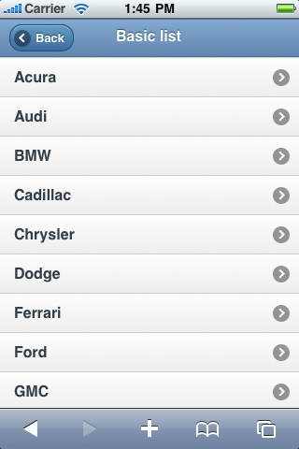
Unordered Lists

Slide 97
Basic listview markup
<ul data-role="listview">
<li><a href="acura.html">Acura</a></li>
<li><a href="audi.html">Audi</a></li>
<li><a href="bmw.html">BMW</a></li>
</ul>

Slide 98
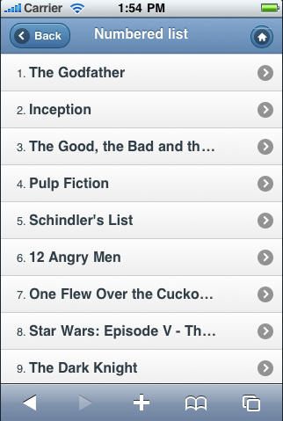
Ordered Lists

Slide 99
Basic listview markup
<ol data-role="listview">
<li><a href=”index.html">The Godfather</a></li>
<li><a href=”index.html">Inception</a></li>
<li><a href=“index.html”>The Good, the Bad and the Ugly </a></li>
</ul>

Slide 100
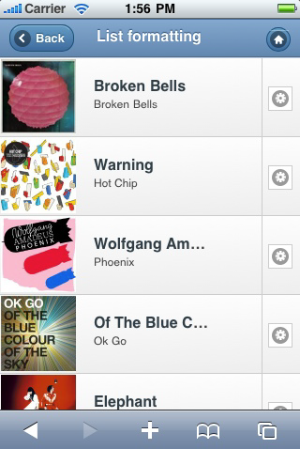
Split button lists
<li>
<a href="bb-detail.html">
<img src="images/album-bb.jpg" />
<h3>Broken Bells</h3>
<p>Broken Bells</p>
</a>
<a href="bb-purchase.html"
data-rel="dialog">Purchase album
</a>
</li>

Slide 101
Icons and count bubbles
<li>
<a href="france/">
<img src="images/gf.png" alt="France" class="ui-li-icon">
France
<span class="ui-li-count">4</span>
</a>
</li>

Slide 102
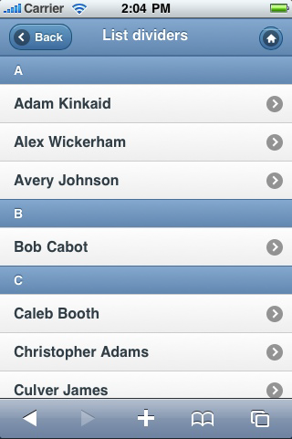
List dividers
<ul data-role="listview">
<li data-role="list-divider">A</li>
<li><a href="index.html">Adam Kinkaid</a></li>
...
</ul>

Slide 103
Auto dividers
<ul data-role="listview" data-autodividers="true”>
<li><a href="index.html">Adam Kinkaid</a></li>
<li><a href="index.html">Alex Wickerham</a></li>
<li><a href="index.html">Avery Johnson</a></li>
<li><a href="index.html">Bob Cabot</a></li>
<li><a href="index.html">Caleb Booth</a></li>
...
</ul>

Slide 104
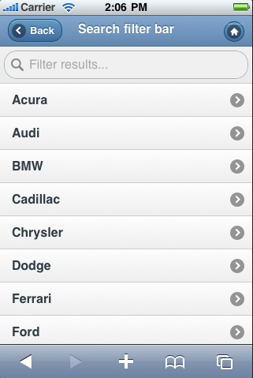
Filter bar
<ul data-role="listview" data-filter="true">
<li><a href="index.html">Acura</a> </li>
<li><a href="index.html">Audi</a></li>
<li><a href="index.html">BMW</a></li>
<li><a href="index.html">Cadillac </a></li>
</ul>

Slide 105
Read-only lists
If a list has the data-role="listview" attribute, but the contents aren't linked, it will display as read-only.
Works with default and inset lists.

Slide 106
Inset Style
Inset
Default
<ul data-role="listview”
data-inset="true">

Slide 107
Forms

Slide 108
Forms
All forms should be wrapped in a form tag that has an action and method that will handle the form data processing on the server.
<form action=“handler.php" method="post">
...
</form>

Slide 109
Forms
The id attributes of form controls need to be not only unique on a given page, but also unique across the pages in a site, because jQuery Mobile's single-page navigation model allows many different "pages" to be present in the DOM at the same time
Pair form controls properly with label elements via the for attribute

Slide 110
Associate labels with IDs
<form action="handler.php" method="post">
<label for="name">Text Input:</label>
<input type="text" name="name" id="name” value="" />
</form>

Slide 111
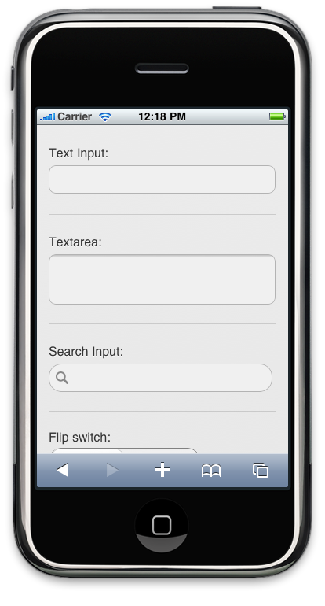
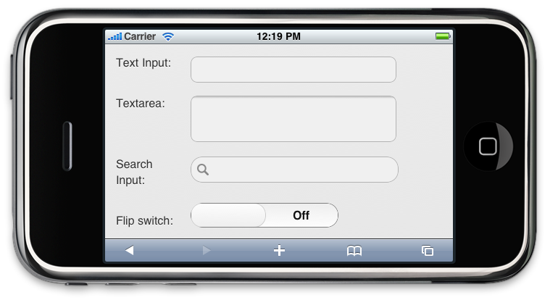
Auto-optimised
Auto-optimised label/input layout based on width

Slide 112
Forms
all form elements must be paired with a meaningful label (for accessibility)
To hide labels in a way that leaves them visible to assistive technologies, apply the helper class ui-hidden-accessible to the label itself:
<label for="username"
class="ui-hidden-accessible”>Username:
</label>
<input type="text" name="username" id="username" value="" placeholder="Username"/>

Slide 113
Text input
<label for="basic">Text Input:</label>
<input type="text" name="name" id="basic" value="” />
Optionally wrap the text input in a container with the
data-role="fieldcontain" attribute to help visually group it in a longer form.
<div data-role="fieldcontain">
<label for="name">Text Input:</label>
<input type="text" name="name" id="name" value="” />
</div>

Slide 114
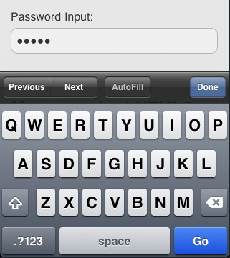
type=“password”

Slide 115
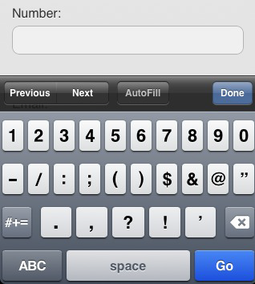
type=“number”

Slide 116
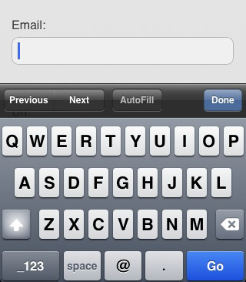
type=“email”

Slide 117
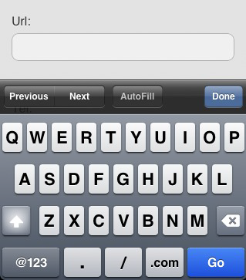
type=“url”

Slide 118
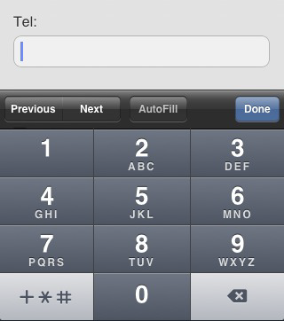
type=“tel”

Slide 119
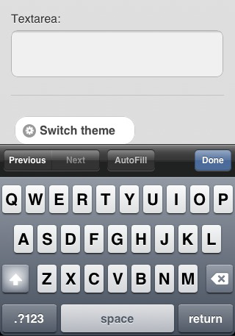
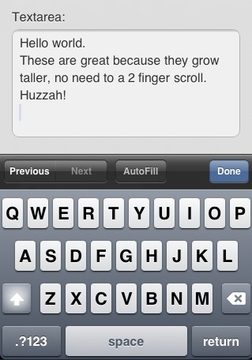
Auto-grow Textarea

Slide 120
Search
<label for="find">Search:</label>
<input type="search" id="find" value="" />

Slide 121
Search

Slide 122
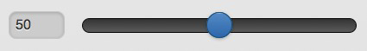
Slider
<div data-role="fieldcontain">
<label for="slider">Input slider:</label>
<input type="range" name="slider" id="slider” value="50" min="0" max="100" />
</div>

Slide 123
Flip Switch Slider
<label for="switch">Flip toggle:</label>
<select name="switch" id="switch" data-role="slider">
<option value="off">Off</option>
<option value="on">On</option>
</select>

Slide 124
Radio button set

Slide 125
Radio button set
<fieldset data-role="controlgroup">
<legend>Choose a pet:</legend>
<input type="radio" name="r1" id="r1" value="choice-1” checked="checked" />
<label for="r1">Cat</label>
<input type="radio" name=”r1" id="r2" value="choice-2" />
<label for="r2">Dog</label>
<input type="radio" name=”r1" id="r3" value="choice-3" />
<label for="r3">Hampster</label>
<input type="radio" name=”r1" id="r4" value="choice-4" />
<label for="r4">Lizard</label>
</fieldset>

Slide 126
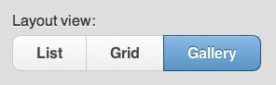
Horizontal Set
<fieldset data-role="controlgroup" data-type="horizontal">
Sunday, April

Slide 127
Checkboxes
<div data-role="fieldcontain">
<fieldset data-role="controlgroup">
<legend>Agree to the terms:</legend>
<input type="checkbox" name="checkbox-1" id="checkbox-1" class="custom" />
<label for="checkbox-1">I agree</label>
</fieldset>
</div>

Slide 128
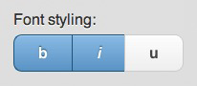
Checkboxes

Slide 129
Select Menu

Slide 130
Select menu
<label for="select-choice-1">Choose shipping method:</label>
<select name="select-choice-1" id="select-choice-1">
<option value="standard">Standard: 7 day</option>
<option value="rush">Rush: 3 days</option>
<option value="express">Express: next day</option>
<option value="overnight">Overnight</option>
</select>

Slide 131
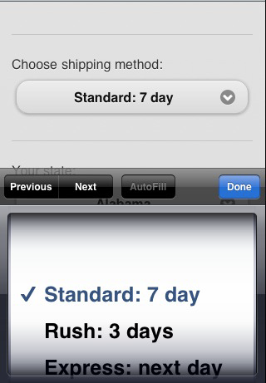
Default: native

Slide 132
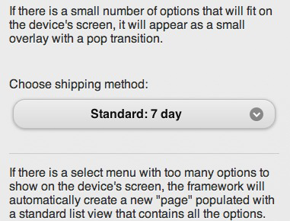
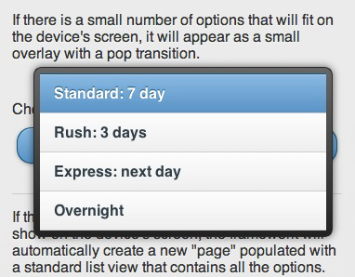
data-native-menu="false"

Slide 133
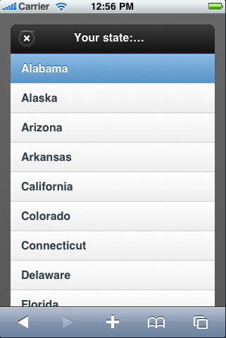
Long Select Menu
Displayed as a pop up window

Slide 134
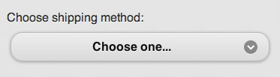
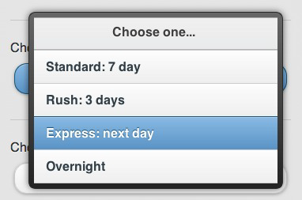
Placeholder option
An option with:
No (or empty) value attribute
No text node
data-placeholder="true"

Slide 135
Select Menu

Slide 136
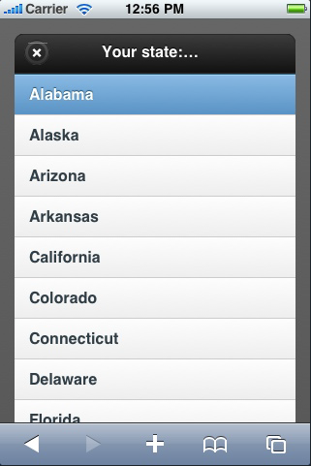
Long Select Menu

Slide 137
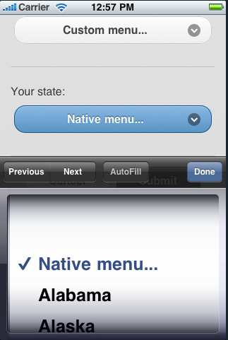
Long native menu

Slide 138
Vertically grouped select inputs
To create a grouped set of select inputs, first add select and a corresponding label.
Set the for attribute of the label to match the ID of the select so they are semantically associated.
Because the label element will be associated with each individual select input, we recommend wrapping the selects in a fieldset element that has a legend which acts as the combined label for the grouped inputs.
Lastly, one needs to wrap the fieldset in a div with data-role="controlgroup" attribute, so it can be styled as a group.

Slide 139
Vertically grouped select inputs

Slide 140
Vertically grouped select inputs
<div class="ui-field-contain">
<fieldset data-role="controlgroup">
<legend>Date of Birth:</legend>
<label for="select-choice-month">Month</label>
<select name="select-choice-month" id="select-choice-month">
<option>Month</option>
<option value="jan">January</option>
<!-- etc. -->
</select>
<!--…Day… -->
<label for="select-choice-year">Year</label>
<select name="select-choice-year" id="select-choice-year">
<option>Year</option>
<option value="2011">2011</option>
<!-- etc. -->
</select>
</fieldset>
</div>

Slide 141
Horizontally grouped selects
Select inputs can also be used for grouped sets with more than one related selections. To make a horizontal button set, add the data-type="horizontal" to the fieldset.
Note that the buttons which trigger the select will resize depending on the currently selected option’s value. Note that browsers without support for display: inline-block; will group the selects vertically, as above.

Slide 142
Horizontally grouped selects
<fieldset data-role="controlgroup" data-type="horizontal">

Slide 143
Layout Grids

Slide 144
Layout grids (columns)
The jQuery Mobile framework provides a simple way to build CSS-based columns through a block style class convention called ui-grid.
Grids are 100% width, completely invisible (no borders or backgrounds) and don't have padding or margins, so they shouldn't interfere with the styles of elements placed inside them.
Four preset configurations layout:
two-column - using the class of ui-grid-a
three-column - using the class of ui-grid-b
four-column - using the class of ui-grid-c
five-column - using the class of ui-grid-d

Slide 145
Layout grids (columns)
<div class="ui-grid-a">
<div class="ui-block-a">
<strong>I'm Block A</strong> and text inside will wrap
</div>
<div class="ui-block-b">
<strong>I'm Block B</strong> and text inside will wrap
</div>
</div><!-- /grid-a -->

Slide 146
Layout grids (columns)

Slide 147
3 and 4-column grids

Slide 148
5-column grids

Slide 149
Multiple row grids

Slide 150
Collapsible content markup
To create a collapsible block of content, create a container and add the data-role="collapsible" attribute.
Using data-content-theme attribute allows you to set a theme for the content of the collapsible. (set it to “none” to have no theme)
Directly inside this container, add any header element (H1-H6). The framework will style the header to look like a clickable button and add a "+" icon to the left to indicate it's expandable.
After the header, add any HTML markup you want to be collapsible. The framework will wrap this markup in a container that will be hidden/shown when the heading is clicked.
By default, the content will be collapsed.

Slide 151
Collapsible content markup
<div data-role="collapsible” data-content-theme=“false”>
<h3>I'm a header</h3>
<p>I'm the collapsible content. By default I'm closed, but you can click the header to open me.</p>
</div>

Slide 152
Collapsible content blocks
<div data-role="collapsible" data-collapsed="false” data-content-theme=“false”>

Slide 153
Theming Collapsibles
To provide a stronger visual connection between the collapsible header and content, add the data-content-theme attribute to the wrapper and specify a theme swatch letter. If this is not set, it will inherit the theme from its parent.
This will apply the swatch's border and flat background color to the content block and changes the corner rounding to square off the bottom of the header and round the bottom of the content block instead to visually group these elements.

Slide 154
Collapsible content blocks
<div data-role="collapsible”> (or with data-content-theme=“a”)
<h3>Header swatch A</h3>
<p>I'm the collapsible content with a themed content block set to "C".</p>
</div>

Slide 155
Collapsible content blocks

Slide 156
Collapsible content blocks

Slide 157
Collapsible set
Collapsible sets start with the exact same markup as individual collapsibles. By adding a parent wrapper with a data-role="collapsible-set" attribute around a number of collapsibles, the framework will style these to looks like a visually grouped widget and make it behave like an accordion so only one section can be open at a time.
By default, all the sections will be collapsed. To set a section to be open when the page loads, add the data-collapsed="false" attribute to the heading of the section you want expanded.

Slide 158
Collapsible set

Slide 159
Collapsible set
<div data-role="collapsible-set">
<div data-role="collapsible" data-collapsed="false">
<h3>Section 1</h3>
<p>I'm the collapsible set content for section B.</p>
</div>
<div data-role="collapsible">
<h3>Section 2</h3>
<p>I'm the collapsible set content for section B.</p>
</div>
</div>

Slide 160
Collapsible set

Slide 161
Collapsible set

Slide 162
Collapsible set
<div data-role="collapsible-set" data-theme=“a"
data-content-theme=“a">

Slide 163
Collapsible set

Slide 164
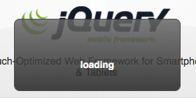
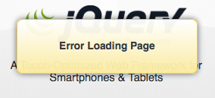
Custom messages

Slide 165
Popups

Slide 167
Popups
<a href="#popupBasic" data-rel="popup">Open Popup</a>
<div data-role="popup" id="popupBasic">
<p>This is a completely basic popup, no options set.<p>
</div>

Slide 168
Popups
<a href="#positionWindow" data-rel="popup" data-position-to="window">
<div data-role="popup" id="positionWindow">
<p>I am positioned to the window.</p>
</div>
Show popup demo

Slide 169
Panels
A panel must be a sibling to the header, content and footer elements inside a jQuery Mobile page. You can add the panel markup either before or after these elements, but not in between.
<div data-role="page">
<div data-role="panel" id="mypanel">
<!-- panel content goes here -->
</div>
<div data-role="header">
</div>
<div role="main" class="ui-content">
</div>
<div data-role="footer">
</div>
</div><!-- /page -->

Slide 170
Panels
The position of the panel on the screen is set by the data-position attribute. The defaults to left, meaning it will appear from the left edge of the screen. Specify data-position="right" for it to appear from the right edge instead.
The display mode of the panel is set by the data-display attribute. The defaults to reveal, meaning the panel will sit under the page and reveal as the page slides away. Specify data-display="overlay" for the panel to appear on top of the page contents. A third mode, data-display="push" animates both the panel and page at the same time.
The api docs:
http://api.jquerymobile.com/panel/

Slide 171
Useful links
Api Documentation:
http://api.jquerymobile.com
Demo Centre:
http://demos.jquerymobile.com/1.4.5/

Slide 172
ThemeRoller demo

